Slide 1

Data analysis of covid-19
SHREEYA IDAGUNJI
SHAMA DIXIT
VIPUL SAPRA
PRATIBHA SINGH

Slide 2
Pandemic & Project Goals !
Coronavirus disease 2019 (COVID–19) is an infectious disease caused by severe acute respiratory syndrome coronavirus 2 (SARS-CoV–2) and was first identified in December 2019 in Wuhan.
Mathematical analysis of infectious diseases using SIR epidemic and endemic models have been studied in the past. Research indicates that certain measures taken by governments are based on various predictions.
These predictions suggest the hospital needs, future deaths, infection peaks and others
Despite lockdown, massive amounts of death and confirmed cases occurred across the world. Data from countries like China, Japan and South Korea indicates that even though lockdowns proposed by governments have caused reduction in the spread of COVID–19 but there are other important factors which could not be neglected .
Our goal here is to run different regression models on the COVID-19 dataset and analyze the data for any pattern between various variables present in the dataset.

Slide 3
Packages ,libraries & importing dataset
install.packages("tidyverse") install.packages("haven")
install.packages("readxl"), install.packages(" GGally ")
library(tidyverse) library(readxl)
library(dplyr), library(GGally),
library(ggplot2) require(graphics) covid_data <- read_excel("C:/Users/vpsap/OneDrive - University of Cincinnati/Desktop/Spring 2021/2nd Flex/Data Analyt Method/owid-covid-data-1.xlsx")

Slide 4
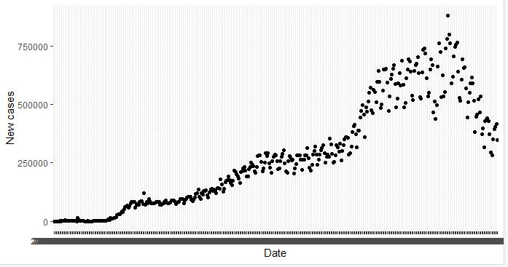
COVID Data - World
The graph below is showing us the number of daily case counts over time in the whole world. This is giving us the clear overview of how new cases varied with time, it gradually increased, reached highest point and then decreased steeply. This graph is determined with the help of following code:
Scatter-Plot for world data
new_cases_World <-data.frame(covid_data$date, covid_data$continent, covid_data$new_cases) new_cases_World <- na.omit(new_cases_World) %>% group_by(covid_data.date) %>% summarise(newcases = sum(covid_data.new_cases)) str(new_cases_World) point_World <- ggplot(new_cases_World) + geom_point(mapping=aes(x=covid_data.date, y=newcases))+ xlab("Date")+ ylab("New cases") point_World
by_jan01 <- covid_data %>% filter(date=="2021-01-01", !is.na(continent))

Slide 5
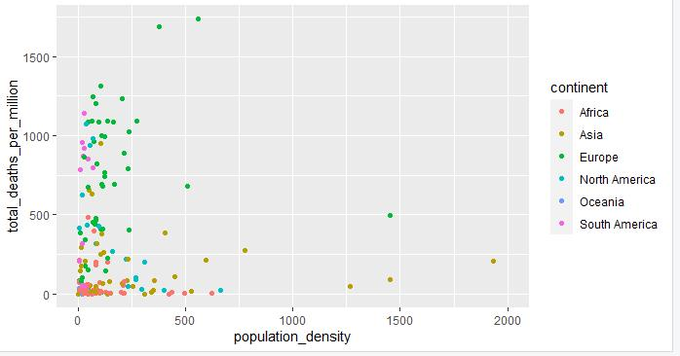
COVID Data - Population Density
There are multiple variables that needs to be compared for each country. First, we’ll look at each country’s population density, and see for notable relation to the number of total cases per million. We see that there are many countries with a lower population density and lower total case/death count. There are a few countries in Asia with very high population density and have differing amounts of total case count per resident. There are countries in Europe, Asia, and South America that have higher total cases per million despite having lower population density.
This plot was derived with the help of following code:
Scatter Plot for population density
scatter_totaldeathspermil_popdensity <- ggplot(by_jan01) + geom_point(mapping=aes(x=population_density, y=total_deaths_per_million, color=continent))+xlim(0,2000) scatter_totaldeathspermil_popdensity

Slide 6
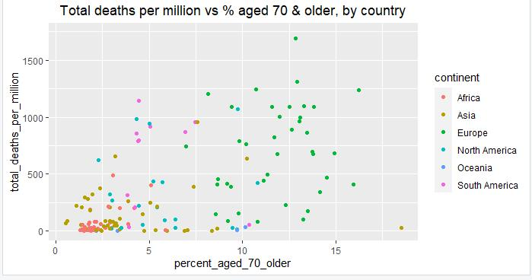
COVID Data- Aged Population
Here we are looking at the number of deaths compared to the percent of people aged 65 or older. We can see that European countries have the highest percentage of older people. Some of these countries have lower deaths per million, and some have higher. African countries have much smaller percent of older populations and total deaths. Several countries in South America have lower percentages of older people than the European countries, but have death counts as high as many of these countries. Therefore, age is not linearly proportional to death. This graph was depicted with the help of following code:
Scatter Plot for aged population
scatter_totaldeathspermil_aged70 <- ggplot(by_jan01) + geom_point(mapping=aes(x=percent_aged_70_older, y=total_deaths_per_million, color=continent))+ ggtitle("Total deaths per million vs % aged 70 & older, by country")+theme(plot.title = element_text(hjust=.5)) scatter_totaldeathspermil_aged70

Slide 7
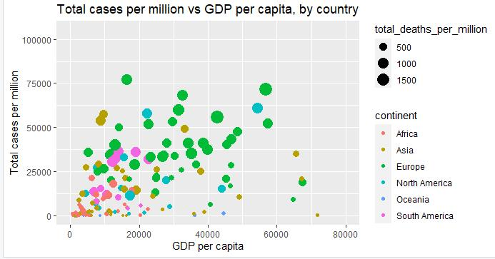
COVID Data- GDP, by country
Another variable that we are examining is Gross Domestic Product. GDP is the abbreviation for Gross Domestic Product and will be used hereafter. We examine each country’s GDP per capita and total cases per million. The size of the bubble represents the total deaths per million.
We see that countries in Europe, Asia, and North America have the highest GDP per capita. Some have lower total cases per million, and some have higher. We see that there are a wide variety of GDP per capita and case count combinations, meaning that how rich or poor a country is does not automatically determine how they will fare with the pandemic; other factors are at play. We used the below mentioned code to determine the graph:
Scatter Plot per capita
scatter_totalcasespermil_gdp <- ggplot(by_jan01) + geom_point(mapping=aes(x=gdp_per_capita, y=total_cases_per_million, color=continent, size=total_deaths_per_million))+ggtitle("Total cases per million vs GDP per capita, by country")+theme(plot.title = element_text(hjust=.5))+xlab("GDP per capita")+ylab("Total cases per million")+xlim(0,80000) scatter_totalcasespermil_gdp

Slide 8
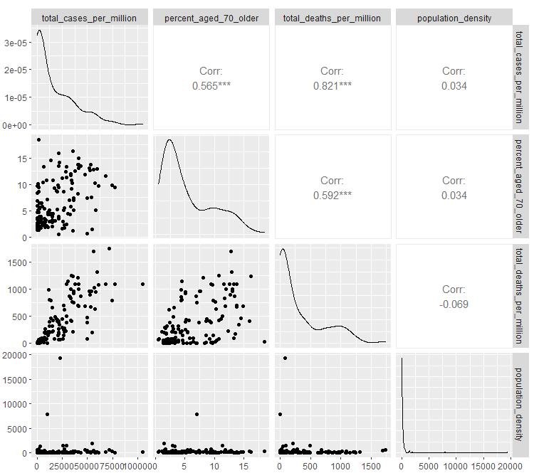
Correlation Matrix 1
Graph
Code
covid_data1 <- read_excel("C:/Users/vpsap/OneDrive - University of Cincinnati/Desktop/Spring 2021/2nd Flex/Data Analyt Method/owid-covid-data-1.xlsx") covidr1 <- covid_data1 %>% filter(!is.na(continent)) %>% filter(date=="2021-01-01")
model_cases_popden <- lm(total_cases_per_million ~ population_density, covidr1) summary(model_cases_popden)
ggpairs(covidr1 %>% select(total_cases_per_million, percent_aged_70_older, total_deaths_per_million, population_density))

Slide 9
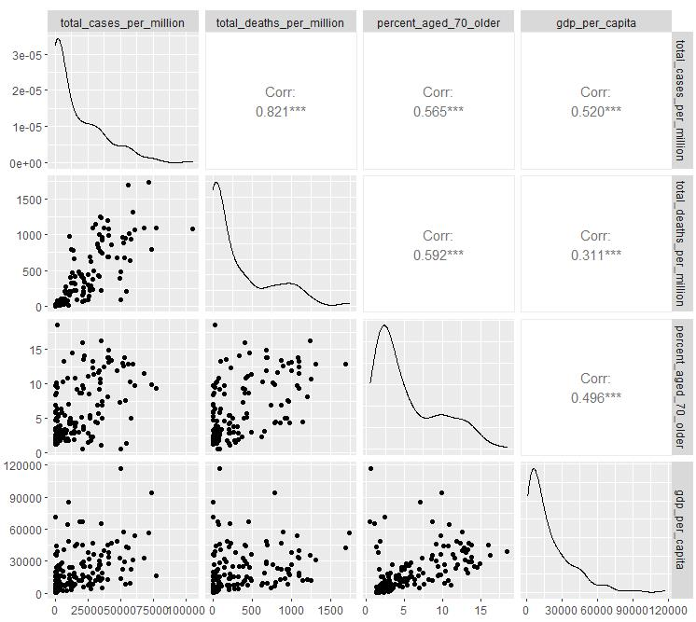
Correlation Matrix 2
Graph
Code
covid_data1 <- read_excel("C:/Users/vpsap/OneDrive - University of Cincinnati/Desktop/Spring 2021/2nd Flex/Data Analyt Method/owid-covid-data-1.xlsx") covidr1 <- covid_data1 %>% filter(!is.na(continent)) %>% filter(date=="2021-01-01")
model_cases_popden <- lm(total_cases_per_million ~ population_density, covidr1) summary(model_cases_popden)
ggpairs(covidr1 %>% select(total_cases_per_million, total_deaths_per_million, percent_aged_70_older, gdp_per_capita))

Slide 10
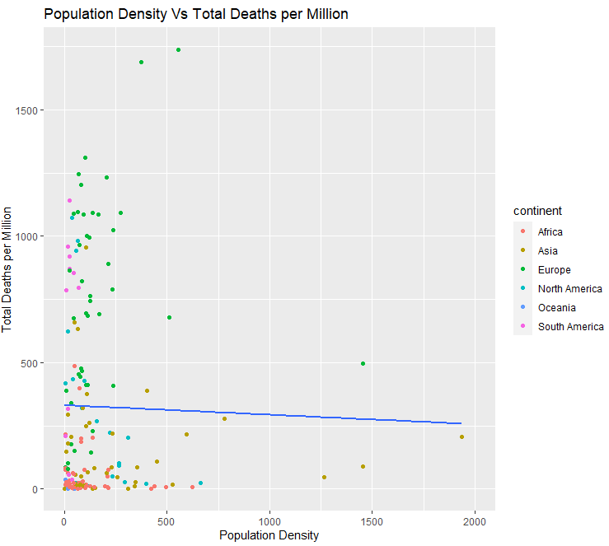
Regression Lines for above Scatter plots
scatter_totaldeathspermil_popdensity <- ggplot(by_jan01) +
geom_point(aes(x=population_density, y=total_deaths_per_million, color=continent))+
labs(x='Population Density', y = 'Total Deaths per Million', title = 'Population Density Vs Total Deaths per Million')+
xlim(0,2000) +
geom_smooth(method = 'lm', aes(x=population_density, y=total_deaths_per_million), se = FALSE)

Slide 11
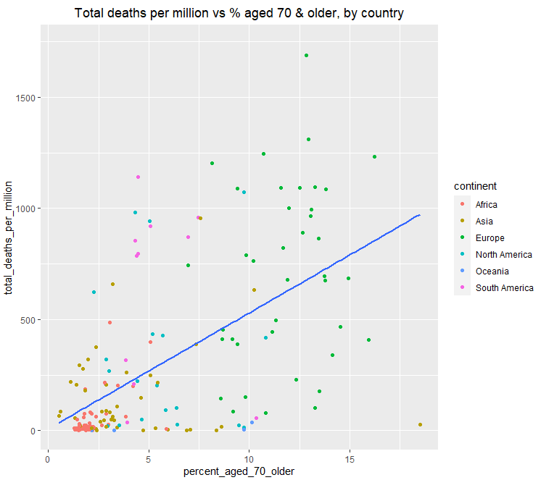
scatter_totaldeathspermil_aged70 <- ggplot(by_jan01) +
geom_point(mapping=aes(x=percent_aged_70_older, y=total_deaths_per_million, color=continent))+
ggtitle("Total deaths per million vs % aged 70 & older, by country")+
theme(plot.title = element_text(hjust=.5)) +
geom_smooth(method = 'lm', aes(x=percent_aged_70_older, y=total_deaths_per_million), se = FALSE)

Slide 12
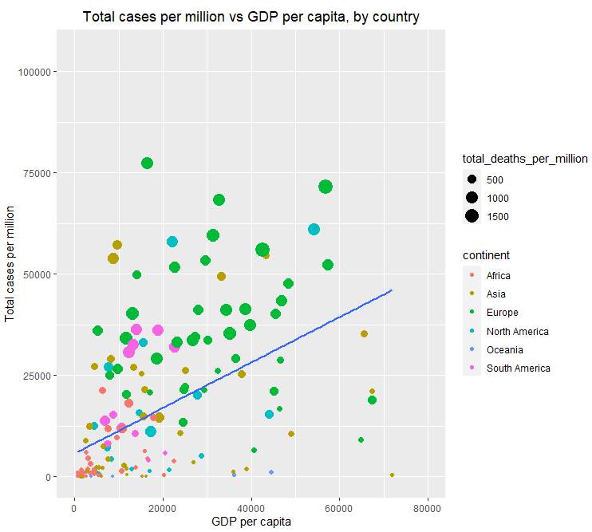
scatter_totalcasespermil_gdp <- ggplot(by_jan01) +
geom_point(mapping=aes(x=gdp_per_capita, y=total_cases_per_million, color=continent, size=total_deaths_per_million))+
ggtitle("Total cases per million vs GDP per capita, by country")+
theme(plot.title = element_text(hjust=.5))+
xlab("GDP per capita")+ylab("Total cases per million")+xlim(0,80000)+
geom_smooth(method = 'lm', aes(x=gdp_per_capita, y=total_cases_per_million), se = FALSE)

Slide 13
Summary
The COVID 19 Pandemic has changed our perspective towards things like personal hygiene, State health Facilities and human to human interaction.
We are on a path to defeat the Virus. We can truly defeat it by learning to control such diseases locally and stop an epidemic from becoming a Pandemic.
To be better prepared for an unforeseen future, we would advice that Nation health services be free if possible, for Senior Citizens.
This Pandemic has been a great leveler and has show there is no difference between rich and poor when it comes to wellbeing.

Slide 14
Thank You!
Any Question?

